Slide 1
Food for Thought: Ingredients for a Delicious Meter-Based Restaurant Program
Amy Allen, David Jump, Raphael Vitti, kW Engineering
Loan Nguyen, Southern California Gas Company
August 30, 2017

Slide 2
Agenda
Introduction
Approach
Model Selection
Results
Conclusion
Questions?

Slide 3
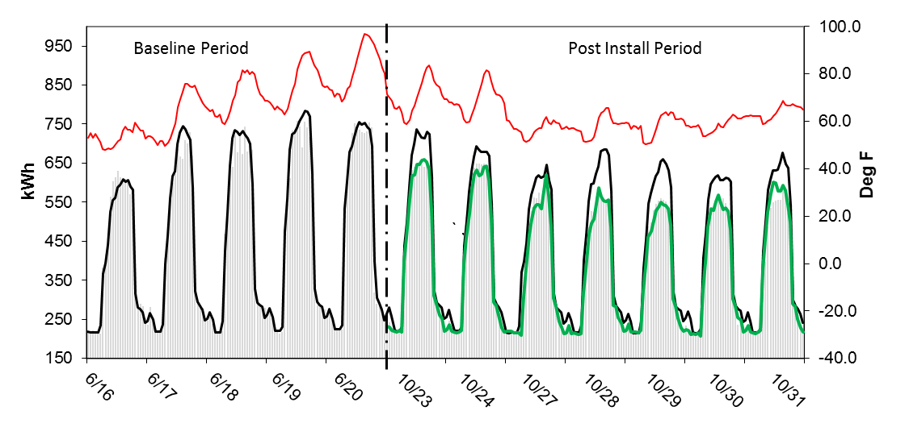
Meter-Based M&V Concept
Notes:
You’re probably familiar with the concept of measurement and verification, or M&V, of energy savings. The recognized energy M&V authority, the International Measurement & Verification Protocol, defines M&V as “the use of measurement to reliably determine energy savings within a facility as the result of an energy efficiency measure or measures.” This work involves M&V of energy savings using a meter-based approach, which is codified in (IPMVP) Option C.
Specifically, option C involves developing a model to predict building energy use, before measures are implemented, and applying it to the post-installation conditions, to calculate an “adjusted baseline.”[Explain plot, and discontinuity in graph.]
[Series in red shows why it’s important to use a model.]
Baseline & adjusted baseline shown in black
Measured post-install energy use shown in green
OAT shown in red

Slide 4
Motivation
California has ambitious efficiency goals
Recent legislation in California has encouraged utilities to pursue programs using “normalized metered energy consumption” in M&V approach
CA gas utility running a pilot program for restaurants
Wanted to determine how well models would meet accuracy criteria, and what level of savings is required
Notes:
The motivation for this study arose from the state of California’s ambitious goals for scaling up energy efficiency. Recent legislation in California has encouraged utilities to pursue programs using “normalized metered energy consumption” in the M&V approach, which corresponds to IPMVP option C.
This gave rise to utility pilot programs using a meter based approach, and we collaborated with the Southern California Gas Company (SoCal Gas) on one of these pilots. As you can imagine from the plot on the previous slide, two important considerations in applying a meter based approach are: the goodness of fit of the baseline energy model, and the level of energy savings that can be determined with confidence. We sought to investigate these points in our study.

Slide 5
Overview of Study
Analyzed sample of restaurants that participated in SoCal Gas’ energy efficiency programs between 2013 and 2015
Developed models for calculating bldg. natural gas usage as a function of weather conditions, and applied best-fitting model to calculate energy savings using IPMVP Option C
Assessed this approach based on level of savings verified, & associated uncertainty

Slide 6
Key Research Questions
What models are most appropriate for M&V analysis?
How accurately can we predict energy use and savings?
How much savings for a typical restaurant is required?
How do M&V calculated savings compare with “deemed” values?
Notes:
Having a well-fitting baseline model is essential for this M&V approach.
Typically thought that this method is applicable for measures with >10% energy savings.
Deemed values are assigned by utilities to common energy efficiency measures.

Slide 7
Characterization of Sample
By Baseline Gas Usage
Sample of 433 restaurants with complete data available, all located in southern California
Energy efficiency measures grouped in two categories: cooking equipment and water heating
Notes:
SoCal Gas provided us with a data set of restaurants that had participated in their gas energy efficiency programs between 2013 and 2015, including monthly natural gas usage data, location, and type of measure implemented. We restricted the sample for this study to sites with a full year of baseline and post-installation energy use data available, and sites with only one measure implemented, since data was not available to distinguish the installation dates of multiple measures. This resulted in a final sample of 433 restaurants, all located in Southern California. (We added a month prior to and after the installation date to define baseline & post-installation periods. )
The energy efficiency measures implemented could be grouped in two categories: installation of more efficient cooking equipment, and installation of more efficient water-heating equipment. All of the measures have associated “deemed” savings through California’s DEER database.
Cooking equipment measures: included replacements of vat fryers, convection ovens, & griddles. Water heating measures included replacements of storage & tankless water heaters.
We did not have data available for either the physical size of the restaurants, nor the volume of sales. However, we could use baseline annual natural gas usage as a proxy for size.

Slide 8
Development & Selection of Model
Weather conditions (degree days or outdoor air temperature) are often used as independent variable
Analyzed four different statistical algorithms (change-point models) to predict monthly natural gas usage over baseline period
2-parameter (linear regression) with HDD and average monthly temperature
3-parameter and 4-parameter with average monthly temperature
Selected model based on accuracy over baseline period, minimizing CV(RMSE), which characterizes the random modeling error
Notes:
Selecting the type of model is an important first step in applying a meter based approach. Models are often based on outdoor weather conditions, expressed in degree days, or average outdoor air temperature.
Normalized monthly natural gas consumption to therms per day. Used the change-point algorithms developed under ASHRAE RP 1050
Plots of CP models at end in presentation Appendix.
Balance point in 2-p HDD model was selected for each site to minimize CV(RMSE), a model accuracy metric. (Balance points ranged from 55F to 75F). Both 2-P HDD and 3-P models have effectively 3 parameters. All other things being equal, having fewer parameters will result in lower uncertainty. (The balance point is effectively the third parameter in the 2P HDD model.)
As programmed, the change-point average monthly temperature model occasionally set the change point to a value that created groups of as little as two data points which were used to calculate the slope of the model. The change point value was selected to minimize the error between the baseline data and the models prediction of the baseline data. The 3P model showed one visible outlier with an impossible savings fraction greater than 100%. As a result, we chose to use the linear heating degree day (HDD) model as the basis of our analysis.
Random modeling error is the difference between the modeled and measured values at each point.

Slide 9
Distribution of CV(RMSE)
Notes:
This plot shows the distribution of CV(RMSE) for each of the four model types. All four model types demonstrated similar distributions of CV(RMSE). Each model type demonstrates CV(RMSE) of 10% (or less) for at least 85% of the sites, indicating that each of the model types performed relatively well for a majority of the sites.
The 3-P change point model and 2P HDD models had the lowest average CV(RMSE) values across all of the sites (approx. 6.8%), and had similar distributions of CV. [And, both have only three parameters (the balance point temperature used to determine heating degree-days is the third parameter in the HDD model). The lower number of parameters keeps the number of degrees of freedom as high as possible, which minimizes uncertainty.] Based on a nuance that undermined the savings calculation with the 3P model, we selected the 2-P HDD model as the basis of our analysis.
ADDITIONAL NOTES (IF QUESTIONS ARISE):
As programmed, the 3-P model occasionally set the change point to a value that resulted in groups of as few as 2 data points being used to calculate a slope. The savings calculated with the 3P model showed one visible outlier with an impossible savings fraction greater than 100%. Thus, we chose to use the linear heating degree day (HDD) model as the basis of our analysis.
Models are explaining variation in natural gas usage over the baseline period—doesn’t mean that gas usage is driven by outdoor air temperature!

Slide 10
Calculating Savings & Uncertainty
Calculated avoided energy use per IPMVP Option C
Used method outlined in ASHRAE Guideline 14 for calculating uncertainty
Set threshold of 50% savings uncertainty at 95% confidence interval, exceeding ASHRAE Guideline 14 recommendation
Notes:
The next step in the analysis was to calculate energy savings and uncertainty, using the HDD-2p model. We applied the baseline model to post-installation conditions to calculate the “adjusted baseline energy use.” We then subtracted the measured post-installation energy use from the adjusted baseline to calculate the avoided energy use, or energy savings. We also compared the M&V calculated savings to “deemed” values.
ASHRAE’s Guideline 14 , which addresses measurement & verification, defines uncertainty as “the range of doubt surrounding a measured or calculated value within which the true value is expected to fall with some degree of confidence.” The use of models in the calculation introduce uncertainty into the savings estimate. ASHRAE Guideline 14 recommends a maximum of 50% savings uncertainty at 68% CI. We wanted to exceed that. We set a threshold of a maximum of 50% savings uncertainty at a 95% confidence interval, to deem savings estimates acceptable. Since the value of savings is in the denominator of the uncertainty calculation, sites with low savings often had high uncertainty. Since negative savings were calculated for some sites, resulting in a negative value of uncertainty, the magnitude of the uncertainty value was used.

Slide 11
Magnitude of Uncertainty at 95% CI vs. Gas Usage for All Sites
Notes:
Note that this plot excludes 16 sites for which the calculated percent uncertainty was very high--greater than 1,000%. As noted, low calculated savings often led to high percentage uncertainties.

Slide 12
M&V Savings vs. Deemed Savings
M&V savings for vat fryers were lower than deemed values at many sites
Water heating measures were disproportionately represented in the “low savings” subset (not shown)
Further investigation needed: site size and savings compared to deemed
Notes:
This plot shows sites with calculated savings > or = 10%, and savings uncertainty <= 50%, categorized by energy efficiency measure. M&V calculated savings for vat fryer replacement measure were lower than deemed savings at many sites. Additionally, sites with larger baseline gas usage tended to demonstrate M&V savings greater than deemed, and smaller sites, smaller. Both of these are potential areas for further investigation.
Water heating measures were disproportionately represented in the “low savings” subset (not shown in this plot).

Slide 13
Results Summary
Notes:
The table shows that, for 178 sites in the dataset (41%), we were able to calculate savings with uncertainty of under 50% at 95% confidence, meeting our threshold to accept the estimate.
Additionally, we could reasonably conclude that 220 more sites (51%) had savings between -10% and 10%, because the baseline models for this sub-set fit well , with an average CV(RMSE) of 6.5%. This indicated that the high uncertainty in this group mostly resulted from the low relative savings rather than inaccurate models. Water heating measures were disproportionately represented in this subset, indicating an area for further investigation. Thus, for 92% of sites in the sample, the baseline models fit well enough that we could either characterize the exact level of savings, or conclude that it was low.
Negative savings presents an area for potential further investigation. Any of these sites could be subject to “non-routine events” that resulted in either over- or under-estimating energy savings. If an estimate of negative or low savings is found to be reliable based on a well-fitting baseline model, it may indicate poor installation or commissioning of the measure.

Slide 14
Conclusions
2-P model based on heating degree days generally models gas usage well for restaurants in sample
Total energy savings calculated through M&V are significantly less than total deemed savings
When baseline model fits well, range of savings <10% can be detected
For over 90% of sites in sample, could either determine savings with acceptable uncertainty(41%), or conclude that savings were low (51%)
Notes:
M&V calculated savings: 230,000 therms/yr, vs sum of deemed savings: 770,000 therms/yr. Possible explanations for this disparity include: inaccurate deemed savings values (earlier discussion of vat fryer replacement measure), poor installation of measures, and non-routine events in the post-installation period (such as an increase in meals served), which could explain negative savings.
As discussed on previous slide, with low baseline model CV(RMSE), (<10%), can conclude that savings has a magnitude of <10% for around 50% of sites in the sample.
Predictability of baseline usage reduces level of savings that can be detected with given level of uncertainty.

Slide 15
Additional Data Needs
Additional independent variables (meals served, water consumption) could make this analysis more comprehensive
With more meta-data, could draw more conclusions about what type of sites are good candidates for this approach
Installation dates for multiple measures would allow consideration of sites with more than one measure installed, and interactive effects
Notes:
SoCal Gas indicated that it would be difficult to get meals served data=>considered proprietary. We could look at other consumption-related variables as a proxy.
As a result of our work, SoCal Gas will request production data from energy efficiency program participants in the future.

Slide 16
Additional Slides for Reference

Slide 17
Areas for Further Study
Notes:
The table shows a breakdown of the sites in the low uncertainty/high savings subset.
Potential area for future study—water heating measures may have resulted in lower than expected savings.

Slide 18
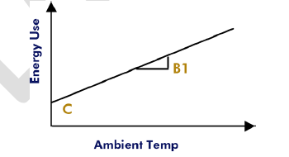
Change-Point Models (2-Parameter)

Slide 19
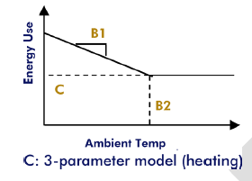
Change-Point Models (3-Parameter)

Slide 20
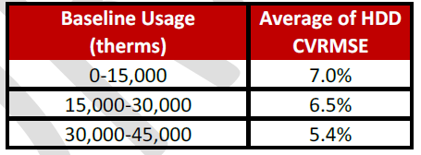
Baseline Model CV and Gas Usage

Slide 21
Average CV(RMSE) by Model Type
Notes:
The linear (2P) heating degree day model (HDD-2P) and three-parameter change point outdoor air temperature model (CP-3P) had the lowest average baseline CV(RMSE), highlighted in the table. Each had similar distributions of CV(RMSE) shown in the previous plot.
Both models had average baseline CV(RMSE) values across 433 sites of approximately 6.8%, and both have only three parameters (the balance point temperature used to determine heating degree-days is the third parameter in the HDD model). The lower number of parameters keeps the number of degrees of freedom as high as possible, which minimizes uncertainty. Based on savings calculated with the 3P model , we selected the HDD model as the basis of our analysis.
ADDITIONAL NOTES (IF QUESTIONS ARISE):
As programmed, the 3-P model occasionally set the change point to a value that resulted in groups of as few as 2 data points being used to calculate a slope. The savings calculated with the 3P model showed one visible outlier with an impossible savings fraction greater than 100%. Thus, we chose to use the linear heating degree day (HDD) model as the basis of our analysis.

Slide 22
Baseline CV(RMSE) for 2-P Model
Notes:
HDD model generally predicts natural gas consumption well across range of baseline natural gas usage.

Slide 23
Save The Dates
AESP’s National Conference
New Orleans, LA
AESP’s Spring Conference
Atlanta, GA
February 19-22, 2018
May 21-23, 2018
For more information - www.aesp.org

